Slide 1
Consumer perspectives on insurance, health and wealth

Slide 2



Agenda
Overview and updates
Insurance, John Hancock Vitality and member health in a COVID world
Customer perceptions of health, insurance, and wealth
John Hancock Vitality Healthy Outcomes
How John Hancock Vitality can drive business

Slide 3



How the Vitality program works
1
2
3
Accumulate Vitality points
Earn a Vitality status
Get Vitality rewards
Earn Vitality points for every day healthy choices like taking a walk buying fresh produce, driving safely, and getting regular check-ups
Each year, your clients’ status level will be determined based on the number of points they accumulate
The higher your client’s Vitality status the greater the potential premium savings – up to 25%* - they can earn and the greater their rewards
0 points Bronze
3,500 points Silver
7,000 points Gold
10,000 points Platinum
*Premium savings are in comparison to the same John Hancock life insurance policy without Vitality PLUS. The level of premium savings are cumulative over the life of the policy and will vary based upon underwriting status, issue age, policy type, the terms of the policy and the Vitality Status achieved. Premium savings are only available with Vitality PLUS.
Notes:
As a reminder how Vitality works…. Flow through text

Slide 4

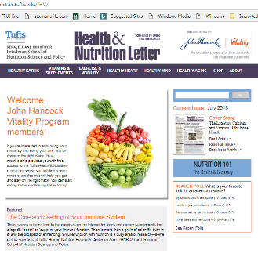
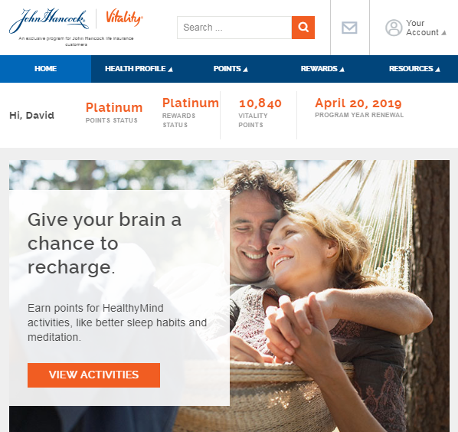




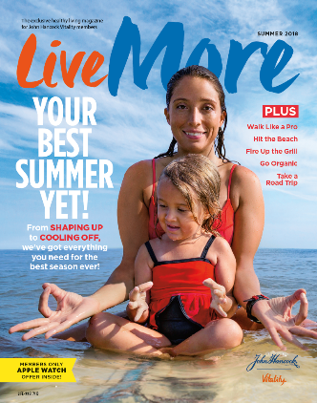
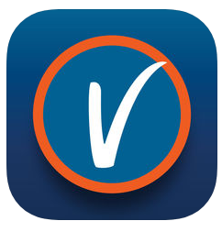

Vitality GO
Vitality GO
Tips, resources, and rewards included on every policy at no additional cost
Access to our John Hancock Vitality website and mobile app
Potential discounts for healthy achievements including, healthy gear, fitness devices, and status based rewards
Expert nutrition and fitness resources, and personalized health goals
Save on fresh fruit and vegetable purchases
Notes:
Vitality GO is included on all John Hancock insurance products at no additional cost – members will gain access to the Vitality website and mobile app, have access to discounts with retailers Garmin, Fitbit, Polar, can save on fresh fruit and vegetable purchases through HealthySavings --- and will have access to expert nutrition and fitness resources.

Slide 5


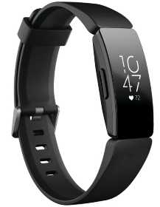





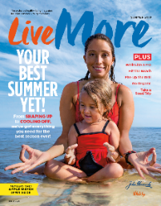



Vitality PLUS
Vitality PLUS
All the benefits of Vitality GO, plus exclusive benefits, premium savings, and rewards for as little as $2/month
Get a complimentary Halo¹
Earn an Apple Watch® for as little as $25 +tax with regular exercise²
Get a complimentary Fitbit Inspire
or
or
Up to 25%* in premium savings
Entertainment and shopping rewards
Save on fresh fruit and vegetables³
Free annual subscription
Plus an easy-to-use app and website with health-related resources
Premium savings are in comparison to the same John Hancock life insurance policy without Vitality PLUS. The level of premium savings are cumulative over the life of the policy and will vary based upon underwriting status, issue age, policy type, the terms of the policy and the Vitality Status achieved. Premium savings are only available with Vitality PLUS. Please see important disclosure at the end concerning Vitality rewards.
Notes:
But, for as little as $2/month Vitality PLUS, in addition to all the benefits of Vitality GO, they are able to earn additional exclusive rewards. These rewards act as both an incentive to participate, but also as a way to engage and earn points… for example, you can earn points using your complimentary Halo Band, or by buying fresh fruit and vegetables throughout the year at participating grocers. (Walk through rewards grid)
And yes… if your customer is not issued with Vitality PLUS, they can upgrade from Vitality GO to the full rewards version of the program in the first 25 months of their policy.

Slide 6




Earning a Vitality Status
Here are some of the ways to achieve a status…
Annual Health Screenings
BMI, Blood Pressure, Cholesterol, and Glucose | 125 pts each
BMI, Blood Pressure, Cholesterol, and Glucose/HbA1c* in a healthy range | 1,000 pts each
Flu shot/Vaccinations
Non-tobacco use attestation | 1,000 points
Education
Complete a short health survey - Bonus for 1st time completion - Complete within first 90 days | 500 pts 500 pts 250 pts
Watch a short nutrition video | 50 pts
Exercise
Walk 5,000 steps | 10 pts/day
Complete a 30-minute gym or at-home workout | 20 pts/day
Burn 300 calories during a workout using a heart rate monitor | 30 pts/day
Mental wellness
Meditate for 10 minutes | 10 pts/day
Log a full 8 hours of sleep when you join a 30-day Sleep Well challenge on the John Hancock Vitality mobile app | 10 pts/night
0 points Bronze
3,500 points Silver
7,000 points Gold
10,000 points Platinum
Vitality points are subject to category maximums.
*For customers living with diabetes, improved or healthy range grants an additional 1,500 points
Notes:
Reaching a Vitality status for your customers to earn rewards is easy – and we make it simple and transparent. There are lots of ways to participate in the program and there are nearly 20,000 Vitality Points available. Shown here is how many members are accumulating Vitality points and boosting their status– which translates into real rewards and savings. While this is not all ways customers can earn a higher status, it is many of the most popular.
Vitality members can earn points for their annual physical and vaccinations, points for simply getting it done, and thousands of points if lab results are in a healthy range. We also have a customized version of the program, John Hancock Aspire, that provides additional points for customers who are living with and are managing their diabetes.
Further, members can earn points by completing health surveys and learning about nutrition and other topics.
Through the mental wellness area of the program. members can earn points for meditating, and even simply getting a good nights sleep.
Perhaps the easiest way to earn points, is by getting credit for the simple workouts they may be doing by walking or workouts at home. And there are earn even more points for intense or advanced workouts –for members who choose link a wearable fitness device, earning points can be even easier since the credit can be almost automatic.

Slide 7

Notes:
I did previously mention Aspire in the prior slide, for those who are unfamiliar Aspire is a version of Vitality that has been modified specifically for those who may be living with Type 1 or Type 2 diabetes.

Slide 8





John Hancock Aspire
Up to 25%* savings on the cost of coverage with Vitality PLUS
A custom pathway to achieve Vitality Points for managing their diabetes as well as improvements in their management
Customized content and education
Additionally, for qualified members, access to Onduo, their tools, coaching and clinical support to help your customers take control of their type 2 diabetes.
The benefits available under Aspire can vary depending on whether the insured has Type 1 or Type 2 diabetes, the type and coverage amount of the life insurance policy purchased and the level of Onduo engagement with the John Hancock Vitality Program. Eligibility for an Onduo membership is also subject to Onduo’s qualification requirements. Certain aspects of Aspire may change over time. There is no coordination between Aspire and any health benefits the insured may receive from an insurance policy, health plan, or any other wellness programs the insured may be enrolled in.
Notes:
Aspire is available to customers with Diabetes and provides them with all the benefits of Vitality PLUS – up to 25% savings on the cost of coverage with Vitality PLUS, a custom pathway to achieving Vitality points for managing their diabetes as well as taking steps to improve their management, custom content and education about diabetes and diabetes management.
Additionally for qualified members, with Type 2 diabetes, the program includes access to Onduo , their tools, coaching and clinical support to help your customers take control of their type 2 diabetes.

Slide 9

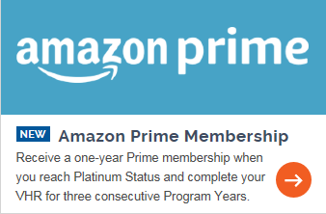

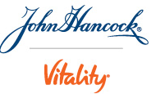
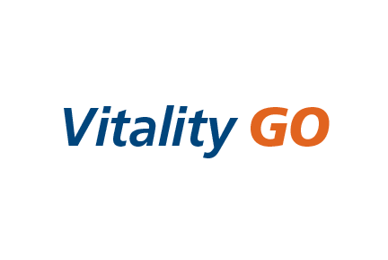
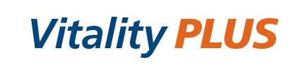




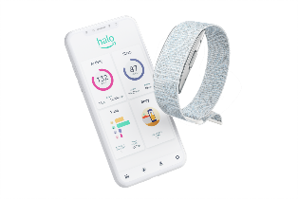
We have continuously evolved and made significant enhancements to the program since launch in April 2015…
Launched Vitality GO & PLUS to deliver Vitality to every policy
New reward category Amazon Prime membership
Improved HealthyFood experience
Introduced Apple Watch
LAUNCH
2015
2020
Launched HealthyFood
Launched HealthyMind
New reward partner
Launched
Introduced
Amazon Halo
Notes:
We have continuously made significant enhancements to the program since launch in April 2015…
When we talk about enhancing and evolving the program - isn’t just adding rewards to the program, its also about providing new points earning pillars in response to the feedback we’ve received from members in addition providing them with the latest technologies to support them and best-in-class reward partners. This includes when we added the Healthy Food benefit to provide customers with a discount on their fresh fruits and vegetables, but also ways to earn points for those purchases and to when we added the Amazon Halo to the program in 2020.
Best of all, these enhancements and additions are available to every John Hancock Vitality PLUS member, regardless if they are a new member or a member who joined when we launched in 2015

Slide 10

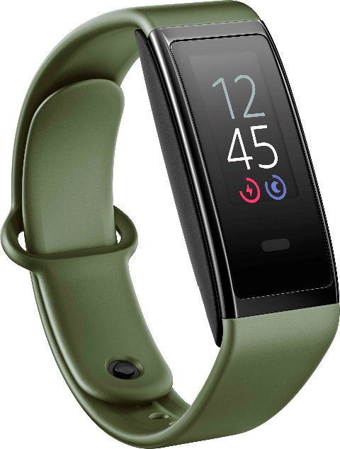
2021 Enhancements
Added the latest devices
Notes:
2021 was no exception, we have added the latest Amazon Halo View which launched in December, as the featured complimentary device, and have also included the brand-new Apple Watch Series 7 as an option for customers to earn their watch for as little as $25+tax.

Slide 11
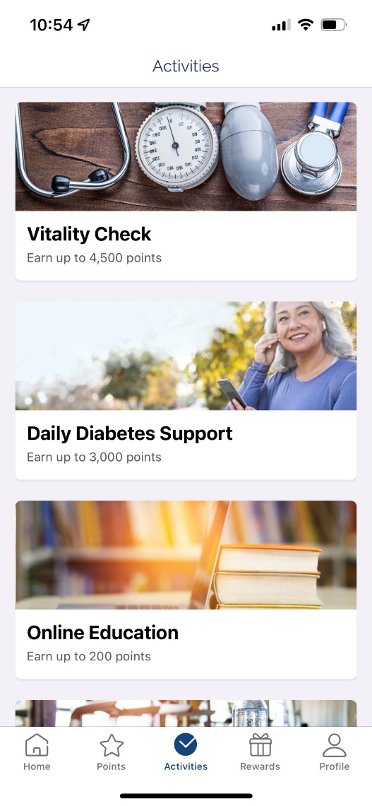
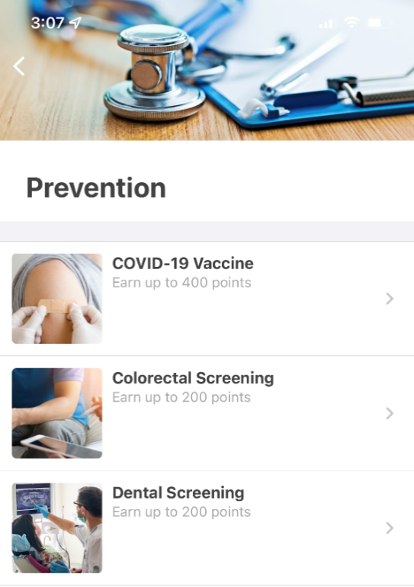
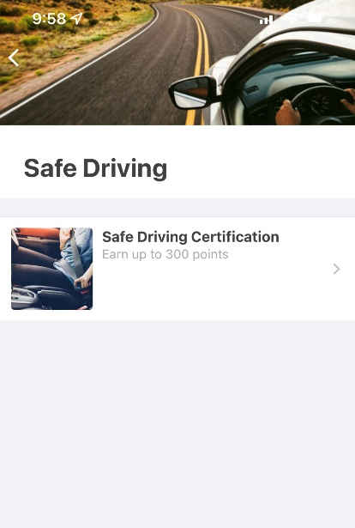
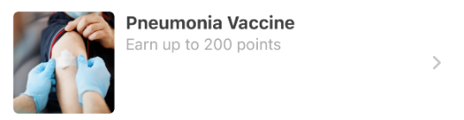

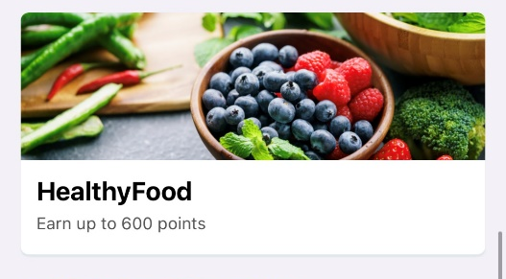
2021 Enhancements
New point earning activities
Refreshed mobile app
Notes:
We added new points earning activities including points for COVID, Pneumonia, and shingles vaccinations adding an additional 800 points available to the program.
We also recognize the clear connection in save driving and living a long life, as such we have added credit for members when they successfully participate in a supported Safe Driving Program. (note: currently Drivewise is the only approved program, and we are adding more throughout the year)
We also understand that members want to be mobile first – as such we refreshed the mobile app that now brings EVERY point earning activity and reward to the mobile app.

Slide 12
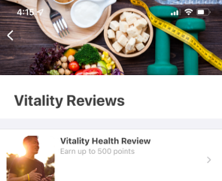
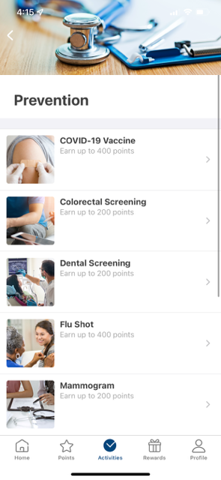
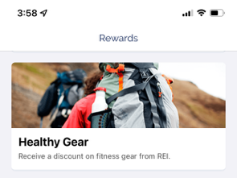
2021 Enhancements
The mobile app refresh led to increased member engagement
Physical Activity reviews increased by 61%
Mammogram submissions increased by 30%
REI redemptions increased by 112%
Source: Internal John Hancock Vitality member data comparing July 2021 – Sept 2021 to October 2021-December 2021
Notes:
Because the program was meeting customers to where they wanted to engage, via the mobile app, we saw increases in submissions of a number of key areas in the program. From providing members easy access to quick point earning activities like Vitality Reviews, to submitting for credit for preventative care they were completing, to even getting access to high-value rewards.

Slide 13







Meeting members needs through the COVID-19 Pandemic
At-home workout points
Workout points for First Responders
Proactively Refunded Hotels.com nights
Hosted Virtual 5K & Auto Awarded Points
Points for COVID Vaccination
Q1 2020
2022+
New Goal: Stop the spread of germs
Auto-awarded Vitality Check Points
Mailed face coverings
Piloted At-home Biometrics
Notes:
Not only is this about changing the program to keep up with technology, but also to keep up with change.
Over the last 2 years the world has changed, as have the needs of our customers… and we met our customers where they were in the program to provide them with added support, tools, and program enhancements and modifications to drive engagement. Youll see here when gyms closed in March of 2020, we added a way for members – even without a wearable device – to get credit for at-home workouts – we mailed customers face coverings to members – and most recently we added points for members who chose to get their covid vaccination.
ANIMATE – I’d consider asking yourself– what did other carriers do to support their customers during covid? Did any do this much?

Slide 14
Consumer sentiment
Notes:
Now lets dive into what we are seeing consumers talk and think about as it comes to their health, insurance, and connected health throughout and post pandemic.

Slide 15

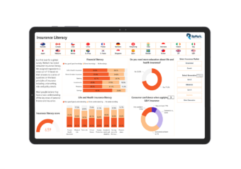

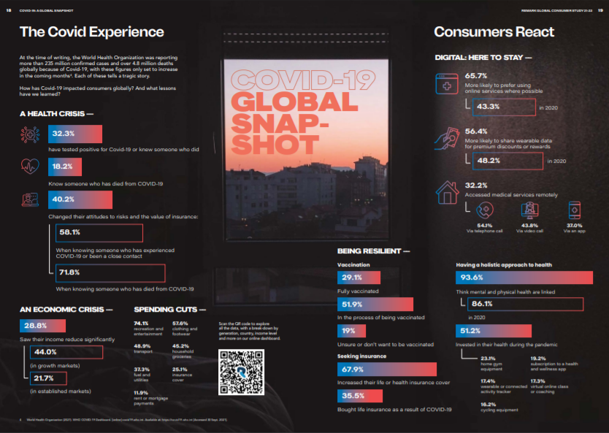
Consumer sentiment
SCOR/ReMark 2021-2022 Consumer Research Study
“Our consumers are educated, knowledgeable and keen to consider insurance not only to protect from risks, but also for their health & well-being. And they rightly expect more…”
Notes:
ReMark (a SCOR reinsurance company) does an annual research study globally, but with cuts and insights by country, market, and age demographic.
With insights indicating that insurance is in increasingly high demand with incredible amounts of data and research into the consumer zeitgeist revolving around the pandemic, health, perceptions of insurance, tech integrated health and more.
The key take away is , and pulled from a direct quote from the summary of the report is that, consumers are educated, knowledgeable and keen to consider insurance not only to protect from risks, but also for their health & well-being. And they rightly expect more.
And at John Hancock we can provide them with exactly that… and including the “MORE” they are looking for.

Slide 16






A focus on health improvement…
Reconnect Life Survey
John Hancock Vitality
57% of people said the pandemic has made them more proactive about their health¹
In our NPS surveys “Motivation to live a healthier life” is the #1 reason members rating us a 10! ²
6 out of 10 indicate that living healthy plays a very large role in their day-to-day life¹
John Hancock Vitality member engagement increased by 20% during the pandemic. ³
6 of 10
56% are seeking to be more physically active to increase resilience to illness¹
85% of members who engaged in Vitality in their first year stayed engaged year over year. ⁴
1. ReMark Global Consumer Study 2021-2022; December 2021 https://www.remarkgroup.com/en/global-consumer-study
2. Based on John Hancock Vitality Medallia Customer Surveys as of Dec 2021
3. Engagement increase based on average monthly points totals for 8/1/18 to 2/28/20 as compared to 3/1/20 to 8/31/21
4. Based on completed at least four policy years for registered and active Vitality PLUS members who received at least Gold in their first year and achieved at least Silver in all years. (Policies with issue dates 2015-2017)
Notes:
We can see that there is a clear focus on health improvement.
Walk through each of the 3 left hand stats
[ANIMATE]
And we also see this echoed on the Johnhanccok Vitality side with how members are engaging in the program.
Walk through each of the 3 stats on the right that reinforce the left

Slide 17





Connected Health and wearables…
Reconnect Life Survey
John Hancock Vitality
64% indicate that health and wellness apps is one of the top 3 ways to improve their health¹
John Hancock Vitality mobile app users log in an average 4 times per day²
4x
Nearly 2/3 of people indicated they currently use or are interested in a wearable¹
7 out of 10 John Hancock Vitality members have linked a fitness device to the program² – and more using other tools!
8 out of 10 indicate premium discounts is the most attractive incentive¹
93% of John Hancock Vitality PLUS members are realizing financial benefits from their engagement³
1. ReMark Global Consumer Study 2021-2022; December 2021 https://www.remarkgroup.com/en/global-consumer-study
2. Based on internal John Hancock Vitality member engagement data as of December 2021
3.Year 1 status attainment of Silver, Gold, or Platinum for active and registered Vitality PLUS members as of year-end 2021.
Notes:
Ownership and interest in wearables is up

Slide 18






SCOR/ReMark 2021-2022 Consumer Research Study
There was a 30% increase in 2020 and additional 33% increase in 2021 on the perceived value of insurance
And 2 out of 3 who felt that way were looking to increase coverage
Motivations and behaviors of consumers have changed – and John Hancock Vitality is at the intersection of these needs!
In 2021, COVID related events was the #3 reason that led consumers to buy insurance
2 out of 3 look to professionals for advice regarding insurance
Outranking “getting married”!
Source: ReMark Global Consumer Study 2021-2022; December 2021 https://www.remarkgroup.com/en/global-consumer-study
Notes:
I am so excited to see these stats, but we also saw the study dive into customer perception about insurance, the buying process, and more…
We’ve found…
There is a heightened appreciation for insurance – and its even higher if they tested positive and even higher if they know someone who died from COVID
#1 was Nothing specific, #2 was recommendation from a friend/family member
The vast majority of consumers want to work with professionals for insurance advice– and being able to present a solution that provides them with what they are looking for is important. [ANIMATE]
We have the right solution at the right time… Vitality is at the intersection!

Slide 19
Engagement and Healthy Outcomes
Notes:
Not only are we seeing strong engagement results, we are seeing positive outcomes from our mutual customers…

Slide 20




Vitality is good for your business
Consumers want Vitality
In 2021 we reached over 100,000 customers with John Hancock Vitality
Vitality PLUS cases are 51% more likely be placed in force³ than non-Vitality PLUS cases.
70% of customers⁴ state purchase decision was influenced by the Vitality PLUS offering
2 out of every 3 policies⁵ are issued with Vitality PLUS
Based on internal John Hancock Vitality reporting of Vitality PLUS and GO customers
As reported by LIMRA, March 2021 https://www.limra.com/en/newsroom/news-releases/2021/limra-u.s.-life-insurance-policy-sales-increase-2-in-2020/
Based upon a rolling 12-month placement ratio of JH new business data of formal applications with Vitality PLUS as compared to cases without Vitality PLUS from Oct 2020 – Sep 2021
Medallia John Hancock Vitality member surveys of Brokerage John Hancock Vitality PLUS members, September 2020 YTD
Based upon internal John Hancock Vitality reporting for 2021
Notes:
Sales have been strong and we know that consumers want Vitality.
#Animate#... We are attracting more and more customers with Vitality.
#Animate# … if we compare Vitality PLUS business to business without Vitality PLUS, Vitality PLUS cases are 51% more likely to be placed in force….
#Animate# … if Vitality can help you close more cases, you may be asking WHY? --- well, 70% of customers said their purchase decision was influenced by the Vitality PLUS offering
#Animate#... And at John Hancock in 2021, 67% of the cases that went in force including Vitality PLUS
Simply put, we know that consumers are attracted to a solution like Vitality…

Slide 21


Vitality is good for your business
What Vitality PLUS can do for YOU
John Hancock Vitality can be a way to engage with your customers during the year or during annual reviews.
Keeping you and your recommendations front of mind!
Vitality PLUS applications are 51% more¹ likely to be placed in force
Vitality PLUS cases are 36% larger² than non-Vitality PLUS cases
Vitality PLUS members have a 94% satisfaction³ rate with their producer nearly 3x higher than the average⁴
1. Based upon a rolling 12-month placement ratio of JH new business data of formal applications with Vitality PLUS as compared to cases without Vitality PLUS from Oct 2020 – Sep 2021 2. Face amount on 2020 and 2021 issued Perm PUL/PIUL policies. Omits Accumulation designated products and term.
3. Based on John Hancock’s Net Promotor Score Data, reported from Medallia responses from 7/1/21 to 12/31/21
4. As compared to Net Promoter Score Data as reported by Statista January 2022 https://www.statista.com/statistics/1033825/nps-insurance-brokers-usa/
Notes:
Vitality isn’t only about what it can do for our customers, but also what it can do for YOU as a distributor…
As mentioned, Vitality PLUS cases are more likely to be placed in force… this allows you to make the insurance conversation more relevant to the customer, and as we learned from the consumer sentiment – you can provide them with a solution that is at the intersection of their financial planning, health, and priorities.
When we compare permanent products that are designed for protection – Vitality cases are 36% larger; they have higher face amounts, and this could be due to the relevance of the sale, increased perceived value that Vitality provides them, and the power of the shared value between them and John Hancock… and of course larger face likely means higher premiums.
Vitality PLUS customers have a 94% satisfaction rate with their producer – which is nearly 3x higher than the average. Vitality puts both you and your recommendations front of mind when they are saving money on their premiums or getting rewarded for the every day things they are doing to stay or become healthy
Simply… Vitality provides YOU with value.

Slide 22



Why? Because it works…
Vitality has proven outcomes
Vitality members are making healthier choices resulting in positive outcomes
80% report similar or better overall health year over year¹
47% reported and improvement in blood pressure¹
Nearly 50% have reported BMI reductions¹
33% with high cholesterol reported bringing their measure in range over the course of a year¹
1. Based on Vitality Health Review self-reported data from registered John Hancock Vitality PLUS members with responses in both 2018 and 2019.
For agent use only. This material may not be used with the public.
Notes:
This all boils down to “Why? Because it works…” after nearly seven years we have proof that Vitality is helping members maintain their health
80% of registered members are reporting similar or better health year over year.
Close to half of members have reported an improvement in blood pressure.
Nearly 50% have reported BMI reductions
33% with high cholesterol brought their measures in range in a year
Simply put, Vitality is working!

Slide 23
How can I help ensure customers succeed?
Notes:
The next logical question is…. How can you help ensure your customers succeed and that both you and they get the benefits from a Vitality PLUS policy?

Slide 24




Activating customers
The best action you can take to help ensure success…
Encourage your customers to get started!
At policy delivery
Thanking them for their business follow ups – ask for referrals!
Getting started guide
As you prepare for periodic reviews
Notes:
Walk through points; highlight the new getting started guide as a resource to help customers get started.

Slide 25
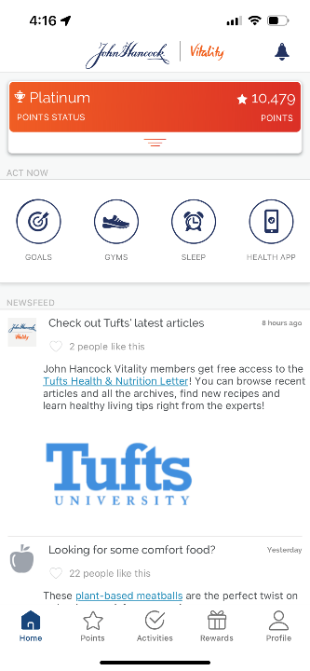
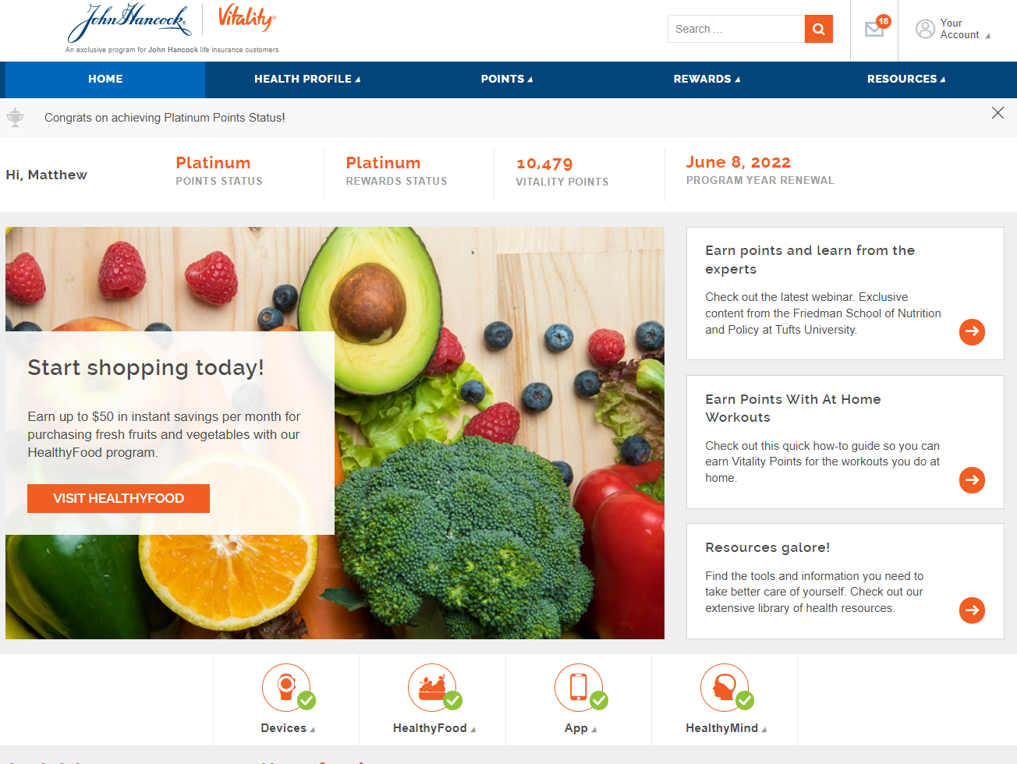
Supporting your customers
Vitality Personal Consultants
VPC@jhancock.com
Notes:
In addition to our customer service teams who will help your customers use the program, we also have for customers who may need or want additional support getting started, a team of experts who can help them get registered. Simply email the VPC inbox with your customers contact information to help them get started. You can be a part of the call too if you want.

Slide 26
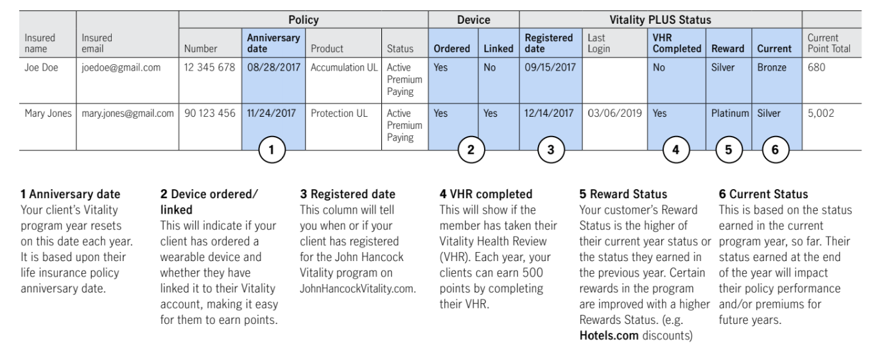
Supporting your customers
Vitality Customer Engagement Reports
Notes:
As agent, on the John Hancock website, you will have access to a report of your book of Vitality PLUS business, letting you see which of your customers have registered, how many points they have, and if they have achieved a higher Vitality Status. This is be a great tool to help you encourage registration, prepare for annual policy reviews, or to congratulate customers who have reached a higher Vitality Status.
Both you, and your designated support staff have access to this monthly report. If you are registered for JHSaleshub you’ll get an email monthly when this report is updated.

Slide 27
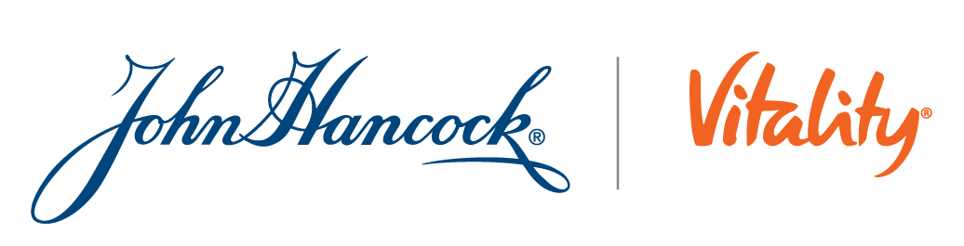
The right solution, at the right time…

Slide 28
Disclosures
*Premium savings are in comparison to the same John Hancock life insurance policy without Vitality PLUS. The level of premium savings are cumulative over the life of the policy and will vary based upon underwriting status, issue age, policy type, the terms of the policy and the Vitality Status achieved. Premium savings are only available with Vitality PLUS.
Insurance policies and/or associated riders and features may not be available in all states.
The available rewards and discounts vary between Vitality GO and Vitality PLUS.
Vitality GO is not available with policies issued in NY & PR. Aspire is not available in New York, Idaho and Puerto Rico.
Hotels.com discounts are not available in New York. In New York, entertainment, shopping, and travel rewards are not available and are replaced by healthy living and active lifestyle rewards.
Amazon Prime membership available to Vitality PLUS members who have reached Platinum Status for three consecutive program years. The Amazon Prime benefit is not available in New York.
REI is not affiliated with the John Hancock Vitality Program. REI does not sponsor, endorse or have any responsibility for this promotion.
Vitality is the provider of the John Hancock Vitality Program in connection with policies issued by John Hancock. John Hancock Vitality Program rewards and discounts are available only to the person insured under the eligible life insurance policy, may vary based on the type of insurance policy purchased and the state where the policy was issued, are subject to change and are not guaranteed to remain the same for the life of the policy.
To be eligible to earn rewards and discounts by participating in the Vitality program, the insured must register for Vitality and complete the Vitality Healthy Review (VHR).
For Term policy with Vitality PLUS with a face amount less than $2,000,000: the insured is only eligible to earn the latest Apple Watch or get a complimentary device, discounts on wearable devices, up to $50 in instant savings per month on fresh produce purchases, a free premium subscription to Headspace, a 15% healthy gear discount, shopping and entertainment discounts, a one-year Amazon Prime membership, exclusive discounts at Hotels.com and a free health check in the first Program Year only. Term policies with face amounts of $2,000,000 and above are eligible for the full suite of rewards and discounts.
Insurance products are issued by: John Hancock Life Insurance Company (U.S.A.), Boston, MA 02116 (not licensed in New York) and John Hancock Life Insurance Company of New York, Valhalla, NY 10595.

Slide 29
Disclosures continued
The complimentary Amazon Halo device and three-year Halo membership are only available to new Vitality PLUS Members and are not available with policies issued in New York, Puerto Rico and Guam. At the end of the complimentary Amazon Halo health and wellness membership, charges will apply automatically to the credit card on file with Amazon.com unless the membership is opted out of. Amazon Halo allows Vitality members to earn Vitality Points for physical activity, Halo Sleep and Halo Programs. The Amazon Halo health and wellness membership is required to earn Vitality Points for Halo Sleep and access the full catalog of Halo content. Other features of Halo are not eligible for Vitality Points with the Vitality Program. Amazon and all related marks are trademarks of Amazon.com, Inc. or its affiliates.
Apple Watch program is not available in New York or Puerto Rico. Apple Watches ordered through John Hancock Vitality may not be shipped to addresses in Guam. Once your clients become a Vitality PLUS member and complete the Vitality Health Review (VHR), they can order Apple Watch by electronically signing, at checkout, a Retail Installment Agreement with the Vitality Group, for the retail price of the watch. After an initial payment of $25 plus tax, over the next two years, monthly out-of-pocket payments are based on the number of Standard Workouts (10,000 to 14,999 steps) and Advanced Workouts (15,000 steps) completed or the applicable Active Calorie thresholds. The step counts required for Standard and Advanced Workouts are reduced for members beginning at age 71+. One-time upgrade fees plus taxes apply if your customers choose (GPS + Cellular) versions of Apple Watch, larger watch case sizes, and certain bands and case materials. For more information, please visit www.jhsaleshub.com. Apple is not a participant in or sponsor of this promotion. Apple Watch is a registered trademark of Apple Inc. All rights reserved.
HealthyFood savings are based on qualifying purchases and may vary based on the terms of the John Hancock Vitality Program. The HealthyFood program is currently not available in Guam.
MLINY012522037-1

