Slide 1
Asset Based Chronic Illness Planning
Using Life Insurance
Advanced Planning
[Presented by:]
[Joe Sample,][Designations per field stationery guidelines]
[Company Approved Title]
[Phone [123-123-1234]]
[joe.sample@prudential.com]
Created Exclusively for Financial Professionals. Not for Use with Consumers.
1052515-00001-00
Notes:
[Welcome audience and introduce speaker.]

Slide 2
Important Information
[
Investing involves risk including possible loss of principal. Information is current as of the date of this material.
Any opinions expressed herein are from a third party and are given in good faith, are subject to change without notice, and are considered correct as of the stated date of their issue.
Merrill Lynch, Pierce, Fenner & Smith Incorporated is not a tax or legal advisor. Clients should consult a personal tax or legal advisor prior to making any tax or legal related investment decisions.
Bank of America Corporation (“Bank of America”) is a financial holding company that, through its subsidiaries and affiliated companies, provides banking and investment products and other financial services .
Merrill Lynch, Pierce, Fenner & Smith Incorporated (also referred to as “MLPF&S” or “Merrill”) makes available certain investment products sponsored, managed, distributed or provided by companies that are affiliates of Bank of America Corporation (“BofA Corp.”). MLPF&S is a registered broker-dealer, registered investment adviser, Member SIPC and a wholly owned subsidiary of BofA Corp. Merrill Lynch Life Agency Inc. (“MLLA”) is a licensed insurance agency and a wholly owned subsidiary of BofA Corp.
Merrill offers a broad range of brokerage, investment advisory and other services. There are important differences between brokerage and investment advisory services, including the type of advice and assistance provided, the fees charged, and the rights and obligations of the parties. It is important to understand the differences, particularly when determining which service or services to select. The views and opinions expressed in this presentation are not necessarily those of Bank of America Corporation; Merrill Lynch, Pierce, Fenner & Smith Incorporated; or any affiliates. Merrill has not participated in preparing this presentation and accepts no responsibility for the accuracy of the information contained herein.
Nothing discussed or suggested in these materials should be construed as permission to supersede or circumvent any Bank of America, Merrill Lynch, Pierce, Fenner & Smith Incorporated policies, procedures, rules, and guidelines.
Investment products offered through MLPF&S and insurance and annuity products offered through Merrill Lynch Life Agency Inc.:
Are Not FDIC Insured | May Lose Value | Are Not Bank Guaranteed
Are Not Insured by Any Federal Government Agency | Are Not Deposits | Are Not a Condition to Any Banking Service or Activity
]
Notes:
[For use in Merrill Lynch only]

Slide 3
Historical Inflation Rate
Source: United States: inflation rate from 1900 to 2020, Statista, https://www.statista.com/statistics/191077/inflation-rate-in-the-usa-since-1990/, accessed September 10, 2021.
3
Notes:
Inflation probably isn’t a topic that most of us think about every day, yet it’s omnipresence has a significant impact on our lives. Recently those concerns have been brough back to the front of our minds, as the significant government spending in response to the COVID-19 pandemic has led to inflationary fears going forward. During our presentation today, we plan to explore how are clients are reacting to this problem, and why it might be an issue for them long term as part of their financial strategy.

Slide 4
Agenda
How are client’s reacting?
How can we help?
What are the alternatives?
Notes:
Here’s today’s agenda:
[Read Slide]

Slide 5
What are clients doing?
Notes:
[Read Slide]

Slide 6

Clients Who May Benefit…
Age 55 + and family oriented
Minimum net worth of $1,000,000 and sufficient liquid assets to support this strategy (excluding equity in the home)
Hold assets not needed for support
in retirement
Have a financial strategy developed in conjunction with a financial professional that indicates that the client has sufficient income from other sources to meet current and future retirement income needs
Have a need for death benefit to provide liquidity upon their death
Notes:
And as we are going through this concept, I’d like you to think about clients that you may have work with who look like this:
(read slide)

Slide 7
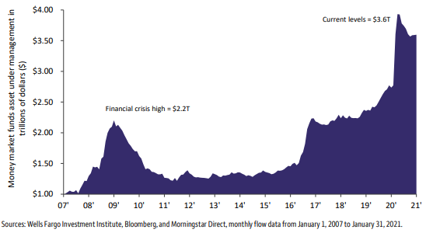
Cash on the sidelines
Notes:
Many clients who have sufficient retirement funds may also have assets that are currently on thee “sidelines”. What have some clients been doing with their money over the past 15 years? Following the financial crisis in 2009, money market funds (MMFs) saw a rise in assets under management to an approximate $2.2 trillion. Within two years, capital was quickly redeployed, but it primarily poured into fixed-income assets. Following the COVID-19 sell-off in 2020, investors exhibited a similar pattern, leading to a record level of $3.9 trillion in MMFs. Almost a year into the recovery, MMF assets have only fallen to $3.6 trillion. A great deal of money remains on the sidelines.

Slide 8
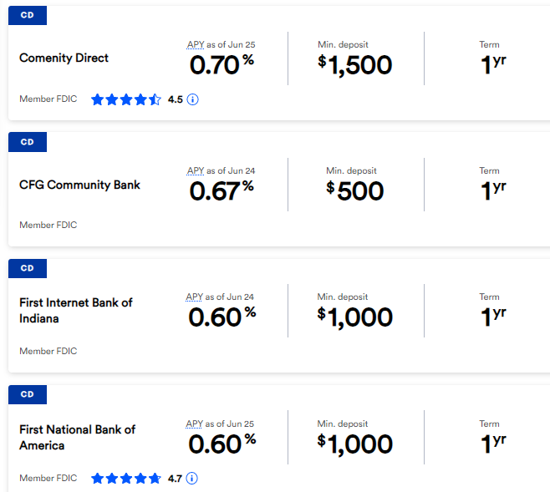
Interest Rates
Notes:
What’s the money on the sidelines earning? In many cases, not very much! Shown here are the top CD rates for one-year CDs nationally, from Bankrate.com. The highest of any listed bank is paying well under 1%!

Slide 9
Why accept a low rate of return?
Safety
Predictability
Wide Selection of Terms
Quick Access to Funds
Notes:
Why are clients willing to leave so much on the sidelines, earning so little interest? There are 4 reasons:
Safety: CDs are not going to experience a negative rate of return. The client will know exactly what their experience will look like up front.
Predictability: With a fixed rate of return, a client is going to know exactly how much interest they’ll receive. This can make budgeting and planning much simpler!
Wide Selection of Terms: CDs come in a variety of durations, with a wide array of terms on how money can be accessed. This is much less restrictive than other fixed alternatives.
Quick Access to Funds: CDs can often be surrendered with little to no penalty, and interest can often be accessed with no penalty at all.

Slide 10
Cons of cash on the sidelines
Inflation
Ongoing taxation
Low returns
Re-investment risk
Notes:
While there are valid reasons for a client to have some money on the sidelines, there are some negative consequences as well:
Inflation: Inflation reflects a general increase in prices and corresponding fall in the value of money. For clients investing in vehicles with a low rate of return, this means that they are losing purchasing power each and every year.
Ongoing Taxation: Interest paid each year in many fixed vehicles will result in taxable consequences to the client. This taxation can effectively decrease a client’s net rate of return.
Low Returns: Safety and security may be accompanied by a low real rate of return.
Re-Investment Risk: While a client may be comfortable with today’s interest rate, they may have to reinvest this money at lower rates of return in the future, depending on the environment at the time.

Slide 11
Reduced Purchasing Power
Source: United States: inflation rate from 1900 to 2020, Statista,
https://www.statista.com/statistics/191077/inflation-rate-in-the-usa-since-1990/, accessed September 10, 2021.
11
Notes:
Long term, this may lead to significant issues for our clients. As their money loses purchasing power due to inflation, they’ll become increasingly more poorly positioned for two areas that we can help them plan for significantly: the impact that a chronic illness need may have on their financial strategy as well as their beneficiary’s ability to use the remaining legacy money to help meet any future needs!

Slide 12
What can we do about it?
Notes:
[Read Slide]

Slide 13

Custom Premier II with BAR
Notes:
What can we do about it? Custom Premier II may be a Swiss army knife, providing the client with the death benefit protection they need and act as a tool for a variety of different life circumstances.

Slide 14
The Versatility of Life Insurance
Valuable for Beneficiaries and Clients
For Beneficiaries:
A life insurance policy pays
out a death benefit to beneficiaries
upon a client’s passing
The death benefit can help beneficiaries maintain a standard of living, pay expenses, pay taxes, etc.
For Clients:
Serve as a source of supplemental income in retirement through policy loans and withdrawals*
Optional riders can provide a
source of funds for clients should they become chronically or terminally ill**
&
*Outstanding loans and withdrawals will reduce policy cash values and the death benefit and may have tax consequences.
**Optional riders may have an additional cost and use of their benefits may reduce or eliminate the death benefit for their beneficiaries.
Notes:
[Read Slide]

Slide 15

Client Profile: Susan
55 years old, teacher
Approaching retirement
Assets in CDs or low interest-bearing accounts
Sufficient retirement income through pension and 403(b) investments
Concerned with planning for chronic illness
Reposition $100,000 of assets
This is a hypothetical example used for illustrative purposes only to describe how the strategies may work. Which strategy works best for clients will depend on their individual facts and circumstances. Actual results will vary.
Hypothetical life insurance policy assumptions on the next slide are for female, age 55, preferred non-tobacco, PruLife Custom Premier II with the BenefitAccess Rider added for additional cost, 6% (5.35% net) rate of return.
Notes:
Let’s talk about Susan, a teacher who is approaching retirement. She resembles many clients for whom this idea might be appropriate:
At or near retirement
Assets in CDs or low interest-bearing accounts
Sufficient retirement income excluding the above listed assets
Concerned with planning for chronic illness

Slide 16
What if I need the money?
Life insurance policy values are available in an emergency
Cash value can be allocated to subaccounts for upside potential
Cash value can be allocated to fixed or indexed accounts for risk-averse clients
$100,000 Single Pay | 0% Rate and maximum charges
Year 1 Surrender Value | $82,631
Year 5 Surrender Value | $80,232
Year 20 Surrender Value | $65,032
Age 90 Surrender Value | Policy Lapses in year 30
$100,000 Single Pay | Fixed Account | 6% ROR
Year 1 Surrender Value | $94,243 | $95,709
Year 5 Surrender Value | $105,444 | $113,988
Year 20 Surrender Value | $177,804 | $241,154
Age 90 Surrender Value | $298,340 | $514,684
Notes:
Custom Premier II is a versatile product that can be designed for a variety of client needs. For Susan, let’s consider how this contract could help her at various stages of her life. If she ever needed the money, the life insurance cash value would be available to her, through withdrawals of surrender value or policy loans. She has a variety of options to allocate her money inside of the contract; let’s consider what happens if she allocates her funds inside the fixed account, as well as what happens if she allocates her funds in the variable subaccounts and earns a 6% rate of return.
[Read Values]
Long term, the growth of her assets is substantial. In addition, her surrender value exceeds her initial premium contribution within the first 5 years of the contract, allowing access if needed for any reason.

Slide 17
What if I die?
Death benefit is generally income tax-free to beneficiaries
Death benefit may grow with any cash value accumulation
$100,000 Single Pay | 0% Rate and maximum charges
Year 1 Death Benefit | $174,308
Year 10 Death Benefit | $174,308
Year 20 Death Benefit | $174,308
Age 90 Surrender Value | Policy Lapses in year 30
$100,000 Single Pay | Fixed Account | 6% ROR
Year 1 Death Benefit | $178,837 | $181,521
Year 10 Death Benefit | $195,060 | $227,670
Year 20 Death Benefit | $236,479 | $320,735
Age 90 Death Benefit | $328,174 | $566,152
Notes:
If she were to die, she’d realize immediate death benefit leverage on her initial premium contribution to her heirs.
[Read Chart]
In addition, as the cash value grows, her death benefit can grow alongside of it with any cash value accumulation!

Slide 18

What if I become chronically ill?
Chronically ill means that the insured:
Is unable to perform at least two Activities of Daily Living (ADLs) without substantial assistance for a period of at least 90 days; OR
Requires substantial supervision and protection from threats to health and safety due to a severe cognitive impairment.
Notes:
[Read Slide]

Slide 19

Addressing Chronic Illness
Optional riders can be added to a life insurance policy* to accelerate the policy’s death benefit in the event of a qualifying chronic or terminal illness
Riders can offer:
No elimination or waiting period
No permanency requirements
Pays for family care/no professional care required
No restrictions on benefit use
Permanent lapse protection
Potentially available in annual lump sum
Benefit grows as policy death benefit grows**
*Riders are typically offered for additional cost and/or underwriting.
** Benefits received under the rider will reduce and may deplete the death benefit available to beneficiaries
Notes:
[Read Slide]

Slide 20
What if I get sick?
$100,000 Single Pay | Fixed Account | Max Monthly Benefit | 6% ROR | Max Monthly Benefit
Year 1 BAR Benefit | $178,837 | $7,153 | $181,521 | $7,260
Year 10 BAR Benefit | $195,060 | $7,802 | $227,670 | $9,106
Year 20 BAR Benefit | $236,479 | $9,459 | $320,735 | $12,829
Age 90 BAR Benefit | $328,174 | $13,126 | $566,152 | $22,646
$100,000 Single Pay | 0% Rate and maximum charges
Year 1 BAR Benefit | $174,308
Year 10 BAR Benefit | $174,308
Year 20 BAR Benefit | $174,308
Age 90 Surrender Value | Policy Lapses in year 30
Notes:
[Read Chart]

Slide 21
What’s the right amount?
$100,000 Single Pay | CPII Fixed Account | CPII Fixed Account | CPII Fixed Account
Year 1 BAR Benefit | $7,153/25 months | $3,725/4 years | $2,483/6 years
Year 10 BAR Benefit | $7,802/25 months | $4,063/4 years | $2,709/6 years
Year 20 BAR Benefit | $9,459/25 months | $4,926/4 years | $3,284/6 years
Age 90 BAR Benefit | $13,126/25 months | $6,836/4 years | $4,557/6 years
Notes:
The chronic illness benefit comes with quite a bit of flexibility, as well. The maximum benefit the client receives is 4% of the death benefit; that said, the client could certainly take a lower amount if that met their needs. In a scenario where they wanted a smaller amount for a longer period of time, they could simply lower their distribution.
[Read Chart]

Slide 22



Not quite chronically ill?
Cash value in a life insurance policy is available to supplement care needs prior to chronic illness
Cash value can be withdrawn or borrowed to:
Take a vacation while you are well enough
Make a payment for a senior living community
Pay for needs around your current house
Notes:
[Read Slide]

Slide 23
Payment flexibility
1 pay? ✓
2 pay? ✓
3 pay? ✓
4 pay? ✓
.
.
.
All pay? ✓
Notes:
Some clients may not want to utilize this strategy as a single premium. That’s OK! Our products have the flexibility to accept premium at whatever pace makes the most sense for a client’s financial needs.

Slide 24










Accelerating the Process
PruFast Track
Prudential’s accelerated underwriting process for eligible applicants
Faster approvals
No exams
Paperless process
Who’s eligible?
All applicants who meet the following requirements:
Age: 18 to 60
Face Amounts: $100,000 to $3,000,000
Quoted Underwriting Category: Smoker or better
Products: Most of Prudential’s term and permanent products
U.S. resident
Notes:
[Read Slide]

Slide 25
Full underwriting
Ages 61+
BenefitAccess Rider available through table D
Client may have health impairments
All rating classes
Full age/amount exam and labs
Normal cycle time
Created Exclusively for Financial Professionals. Not for Use with Consumers.

Slide 26
What are the alternatives?
Notes:
[Read Slide]

Slide 27
What are the alternatives?
Life insurance with a chronic illness rider
Hybrid
long-term care (LTC) and life insurance
Traditional long-term care (LTC) insurance
Notes:
Some financial professionals may wonder what alternatives they have to this type of strategy. In addition to life insurance with a chronic illness rider, traditional long-term care insurance and a hybrid life/LTC policy represent two other viable options. Let’s discuss the differences.

Slide 28
Premium flexibility
Life insurance with chronic illness rider
Significant premium flexibility
Hybrid LTC and life insurance
Generally single or short pay
Traditional LTC
Generally short or lifetime pay
Notes:
[Read Slide]

Slide 29
What if I need cash?
Life insurance with chronic illness rider
Variety of underlying investment options
Cash value accumulation potential beyond initial premium
Primarily fixed account only
Cash value unlikely to exceed original premium
Guaranteed return of premium rider
  Rider may require full surrender
Hybrid LTC and life insurance
Traditional LTC
No cash value
Notes:
[Read Slide]

Slide 30
What if I die?
Life insurance with chronic illness rider
Death benefit can grow if cash value grows
Reduces upon claim
Complements many estate planning strategies
Hybrid LTC and life insurance
Minimal death benefit compared with other life insurance
Residual death benefit if LTC pool exhausted
Traditional LTC
No death benefit
Notes:
[Read Slide]

Slide 31
What if I need care?
Life insurance with chronic illness rider
Double duty dollars
No restrictions/receipts on how benefit is spent
Price stability
Hybrid LTC and life insurance
Larger benefit pool, may have small monthly benefit
Proof of expenses incurred
Only qualified long-term care costs are covered
Traditional LTC
Largest range of LTC options
Use it or lose it
Premiums may change over time
Notes:
What if I do need care? Let’s consider the three options available:
Life insurance with chronic illness rider:
Double duty dollars: The benefit can be used during one’s life if chronic care is needed or to one’s beneficiaries through the death benefit
Chronic illness rider may not require any receipts nor have any restrictions on how the funds are used in the event one is diagnosed as chronically ill
The cost of the chronic illness rider is set in the contract and can not increase
Hybrid LTC and life insurance:
Typically has a larger benefit pool than a life insurance policy with a chronic illness rider; though they may have a smaller monthly benefit
Many such policies require receipts to be reimbursed for any care related expenses
Policies may have restrictions and only cover certain “qualified” long-term care costs
Traditional LTC:
Largest range of benefit options
If the benefit is not needed during one’s lifetime, there is no death benefit
Premiums may be increased over time

Slide 32
Review
How are client’s reacting?
How can we help?
What are the alternatives?
Notes:
[Read Slide]

Slide 33
How can Prudential help?
EXPERIENCED
Advanced Planning Team of attorneys,* accountants,* and consultants
Customized client presentations demonstrating benefits to client
Ability to issue
large face amounts
for wealthier clients AND LARGE CASES
Notes:
[Read Slide]

Slide 34

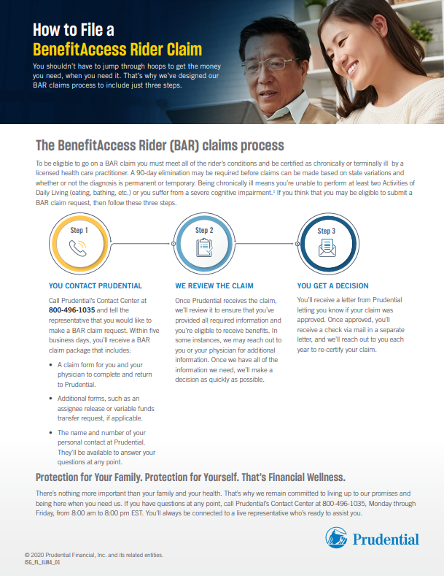


Approaching the market
Notes:
In addition to our Advanced Planning team, we have a variety of marketing materials and tools available to help demonstrate the problem and its solutions to a client. We’ve included examples of several of them on the screen!

Slide 35
Beginning the conversation
Existing clients
Approach someone you already work with who fits the profile
Traditional networks
Work with traditional centers of influence (attorneys, CPAs, etc.) to identify clients
New clients
Get involved with organizations in areas with potential clients that fit the profile
Notes:
How does one begin this conversation?
[Read Slide]

Slide 36
Important Information
This material is being provided for informational or educational purposes only and does not take into account the investment objectives or financial situation of any client or prospective clients. The information is not intended as investment advice and is not a recommendation about managing or investing a client’s retirement savings. If clients would like information about their particular investment needs, they should contact a financial professional.
PruLife® Custom Premier II is issued by Pruco Life Insurance Company in all states except New York, where it is issued by Pruco Life Insurance Company of New Jersey and offered through Pruco Securities, LLC (member SIPC). All are Prudential Financial companies located in Newark, NJ.
Clients should consider the investment objectives, risks, and charges and expenses carefully before investing in the contract and/or underlying portfolios. The prospectus and, if available, the summary prospectus contain this information as well as other important information. A copy of the prospectus(es) may be obtained by contacting your Prudential Life Wholesaler or from prudential.com. Clients should read the prospectus(es) carefully before investing.
It is possible to lose money by investing in securities.
The BenefitAccess Rider is an optional rider that accelerates the life insurance death benefit when the insured is terminally ill or is chronically ill as defined in the rider. It is not Long-Term Care (LTC) insurance. Benefits received under the rider will reduce and may deplete the death benefit. Electing the BenefitAccess Rider results in an additional charge and underwriting requirements. Some benefit payments may be subject to a fee. Other terms and conditions apply and can vary by state. Clients should consult their tax and legal advisors.
Created Exclusively for Financial Professionals. Not for Use with Consumers.
Notes:
Please note the important information on this slide

Slide 37
Important Information
For New York contracts: Please also note the rider is not subject to the minimum requirements of New York law, does not qualify for the New York State Long-Term Partnership Program, and is not a Medicare supplement policy. In addition, receiving accelerated death benefits may affect clients' eligibility for public assistance programs and such benefits may be taxable. Benefit payments may only be made if the payments are subject to favorable federal tax treatment. When determining whether the benefit payments will receive favorable tax treatment, the payment of benefits from all insurance policies must be considered. Accordingly, prior to applying for benefits, you should seek assistance from a qualified tax advisor.
We do not provide tax, accounting, or legal advice. Clients should consult their own independent advisors as to any tax, accounting, or legal statements made herein.
All guarantees, and benefits of the insurance policy are backed by the claims-paying ability of the issuing insurance company and do not apply to the underlying investment options. Policy guarantees and benefits are not backed by the broker/dealer and/or insurance agency selling the policy, nor by any of their affiliates, and none of them make any representations or guarantees regarding the claims-paying ability of the issuing insurance company.
Investment and Insurance Products:
Not Insured by FDIC, NCUSIF, or Any Federal Government Agency. May Lose Value. Not a Deposit of or Guaranteed by Any Bank, Credit Union, Bank Affiliate, or Credit Union Affiliate
Prudential, the Prudential logo, and the Rock symbol are service marks of Prudential Financial, Inc. and its related entities.
FOR FINANCIAL PROFESSIONAL USE ONLY. NOT FOR USE WITH CONSUMERS.
© 2021 Prudential Financial, Inc. and its related entities.
1052515-00001-00
Created Exclusively for Financial Professionals. Not for Use with Consumers.
Notes:
Please note the important information on this slide

